Slide 1


A Fast Local Descriptor for Dense Matching
Engin Tola, Vincent Lepetit, Pascal Fua
Computer Vision Laboratory
EPFL
2008-06-10

Slide 2
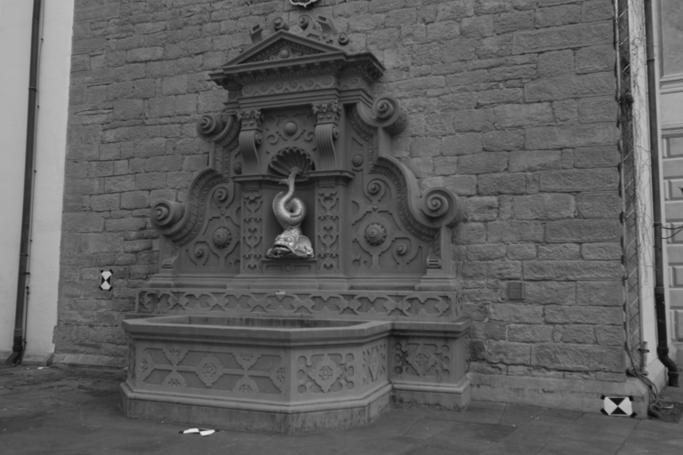
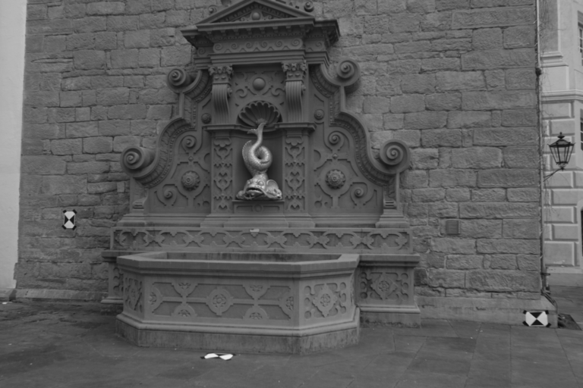
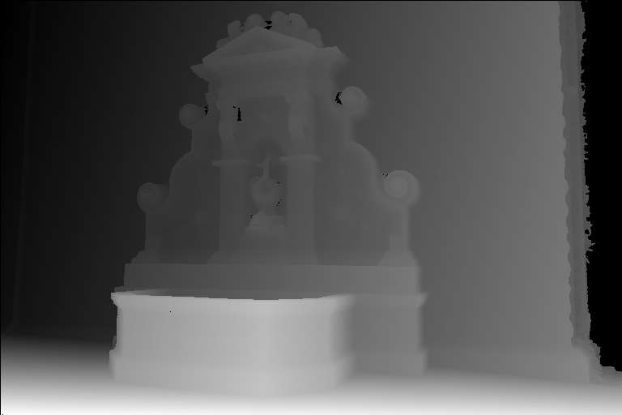
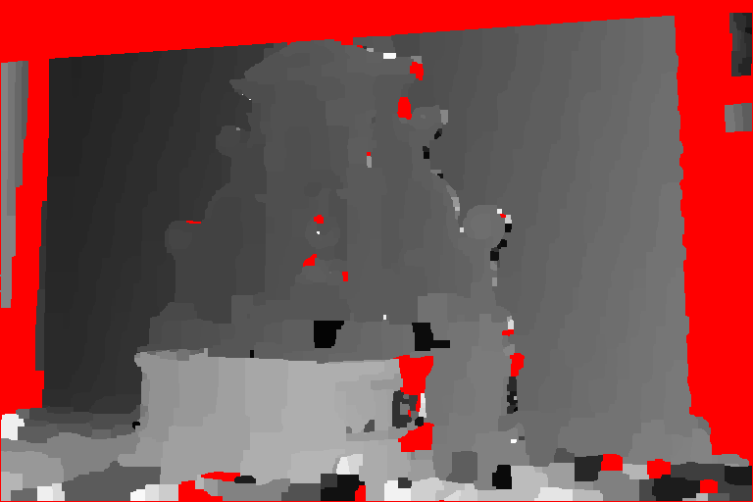
Motivation
Narrow baseline : Pixel Difference + Graph Cuts*
input frame
input frame
groundtruth
pixel difference
* Y. Boykov et al. Fast Approximate Energy Minimization via Graph Cuts. PAMI’01.
Notes:
Narrow baseline stereo is largely a solved problem. Here, you see the result of a very simple graph cuts based algorithm that uses pixel differences as the cost term.

Slide 3
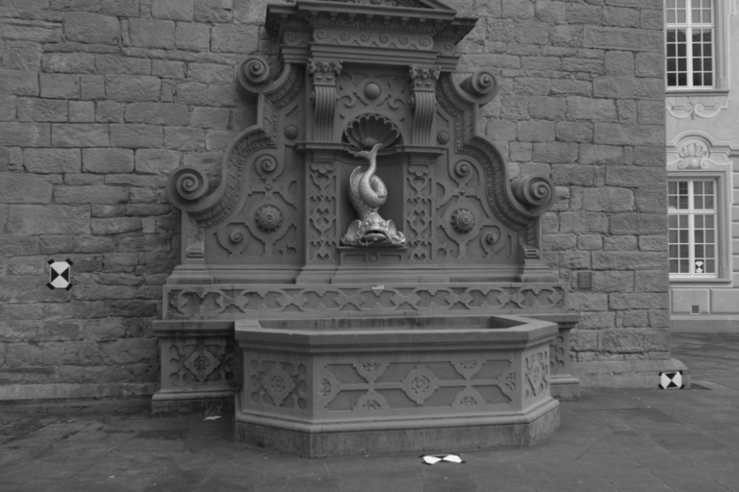
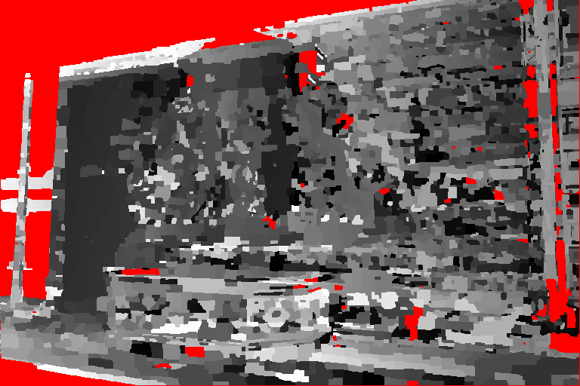
Motivation
USE A DESCRIPTOR
Wide baseline : Pixel Difference + Graph Cuts
input frame
input frame
groundtruth
pixel difference
Notes:
But when you increase the baseline, pixel differences fails. Actually, this approach fails even when we have some image transformations like contrast change. Our intuition here is that what if we use a descriptor instead of the pixel information directly ? It is well known that descriptors work very well on sparse matching problems at feature locations.

Slide 4
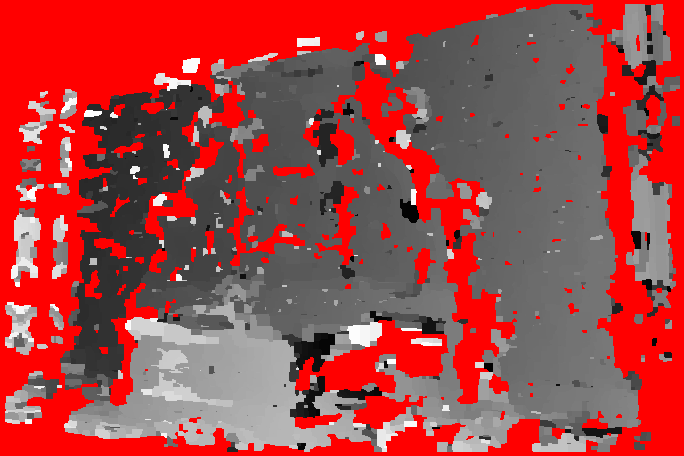
Motivation
250 Seconds
Wide baseline : SIFT Descriptor*+ Graph Cuts
input frame
input frame
groundtruth
SIFT
* D. Lowe. Distinctive Image Features from Scale-Invariant Keypoints. IJCV’04
Notes:
So, we tried to use the SIFT descriptor directly. Although the reconstruction is somewhat better, there are still some problems for example near occlusion boundaries and also it takes ~250 seconds to compute the descriptors at every point in a 800x600 image.

Slide 5
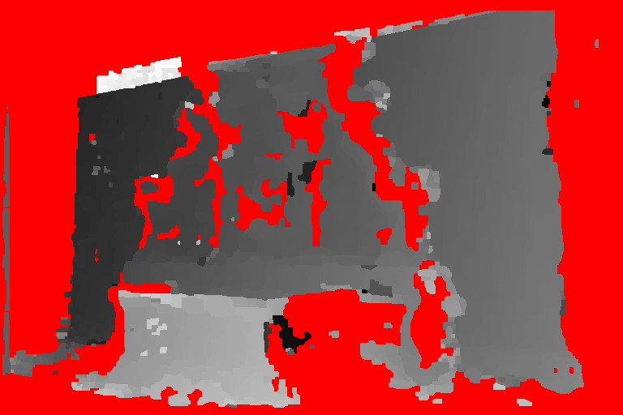
Motivation
5 Seconds
Wide baseline : DAISY Descriptor+ Graph Cuts
input frame
input frame
groundtruth
DAISY
Notes:
Today, we are going to present a method where we use a new descriptor we call DAISY and show that we obtain not only much better results but also we do it a lot faster. It takes only 5 seconds to compute the descriptors at every point in an image.

Slide 6
Motivation
Histogram Based Descriptors: SIFT, GLOH, SURF…
Perspective robustness
Proven good performance
Robustness to many image transformations
Cons
No efficient implementation exists for dense computation
- Do not consider occlusions
Design a descriptor that is as robust as SIFT or GLOH but can be computed much more effectively and handle occlusions.
Notes:
Histogram based methods have many advantages like their proven performance and robustness to various transformations
Since these are never used for dense computation before, they do not consider occlusions and no efficient algorithm exists for dense computation of these descriptors.
Let’s see what can we do to handle these problems.

Slide 7
Problem Definition
epipolar line
epipolar line
Input Frames
Virtual Camera
Notes:
We handle the general problem by first discretizing the back-projected ray and testing the matching score of the 2 projected locations by their descriptors computed in the direction perpendicular to the epipolar line. Although, image rectification can be applied, we want our algorithm to be able to generalize to handle more than 2 input images and therefore, we won’t rectify the input images.
The ability to compute descriptors in any direction is therefore an important issue and we’ll see how this will make the adaptation of SIFT for dense computation impossible.

Slide 8
Histogram based Descriptors…
SIFT Computation
descriptor
…
Notes:
These different arrows actually represent the direction of the gradient. Magnitudes are not represented for visual clarity.
When we want to compute the descriptor at a point, we overlay its grid on top of the gradient and compute histograms of the gradient within all of these sub-regions. The overall stacking of the histograms becomes the raw descriptor.

Slide 9
Histogram based Descriptors…
SIFT Computation
Notes:
If we consider the computation of the descriptor next to the current pixel, we’d see that most of the histograms are the same and we don’t need to re-compute them. However, if you want to compute the descriptor in a different orientation, the histograms change completely because of both the weighting scheme and the square shape of the sub-regions of SIFT.

Slide 10
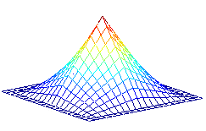
SIFT -> DAISY
SIFT
+ Good Performance
Not suitable for dense
computation
Notes:
So, we know that SIFT has a very nice performance record. But, it is not suitable for dense computation as it is.

Slide 11
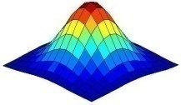
SIFT -> DAISY
SIFT
Sym.SIFT
GLOH*
+ Good Performance
+ Gaussian Kernels : Suitable for Dense Computation
+ Good Performance
+ Better Localization
Not suitable for dense
computation
Not suitable for dense
computation
* K. Mikolajczyk and C. Schmid. A Performance Evaluation of Local Descriptors. PAMI’04.
Notes:
However, we can make it more suitable by changing its weighing kernel to a Gaussian and use circular regions which are actually realized by the Gaussians naturally. Additionally, we also know that GLOH has a better record in localization but it also is not suitable for dense computation (because of its grid shape and weighting again)

Slide 12
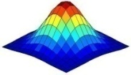
SIFT -> DAISY
DAISY
Sym.SIFT
GLOH
+ Suitable for dense computation
+ Improved performance:*
+ Precise localization
+ Rotational Robustness
+ Suitable for Dense Computation
+ Good Performance
+ Better Localization
Not suitable for dense
computation
* S. Winder and M. Brown. Learning Local Image Descriptors in CVPR’07
Notes:
We propose to merge these two ideas where we have circular regions defined by Gaussians with increasing variance as you go away from the point center. Actually, in a recent publication, a grid similar to our DAISY has been shown to outperform SIFT for sparse feature matching also. But our motivation in using a grid like this also stems from its computational advantages.

Slide 13
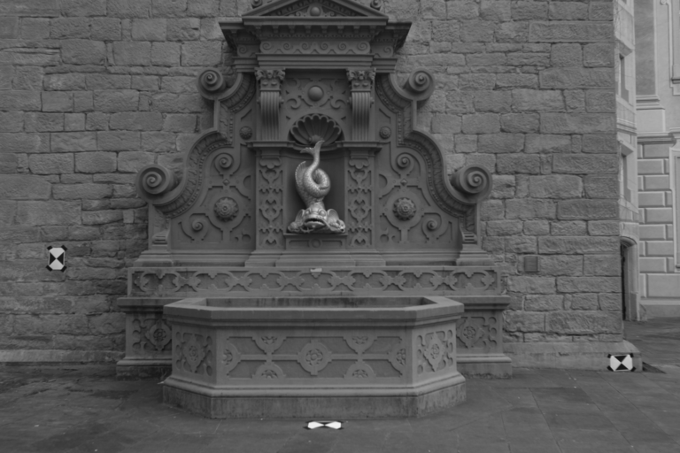
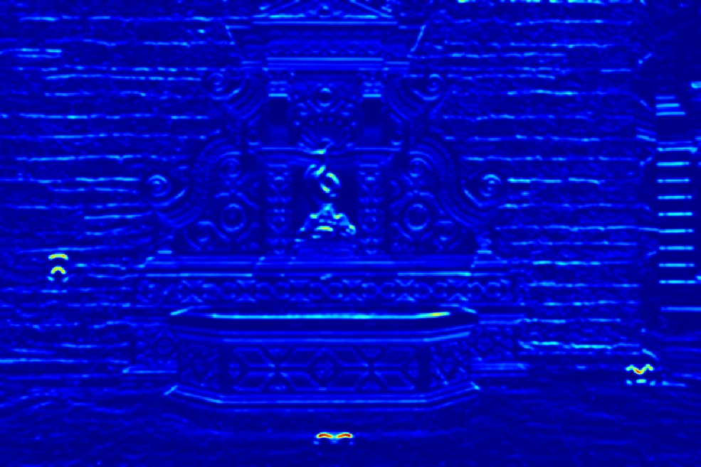
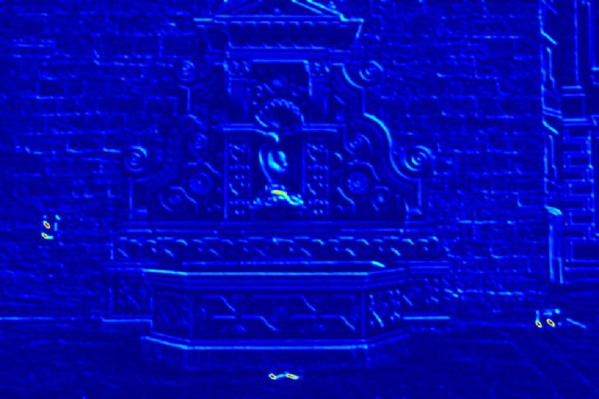
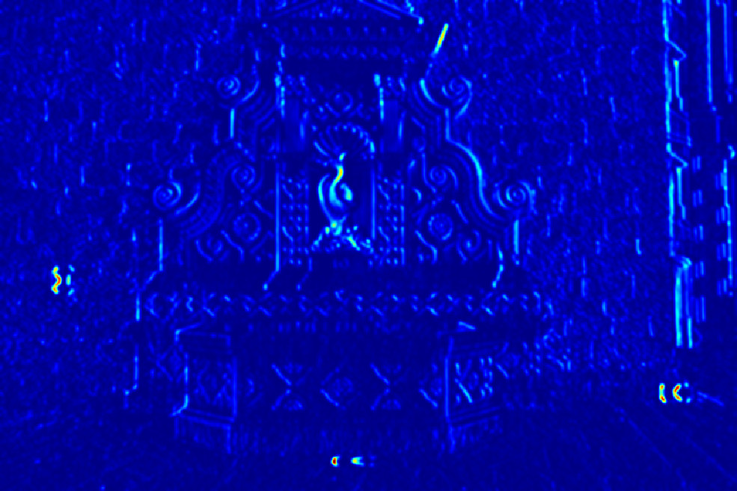
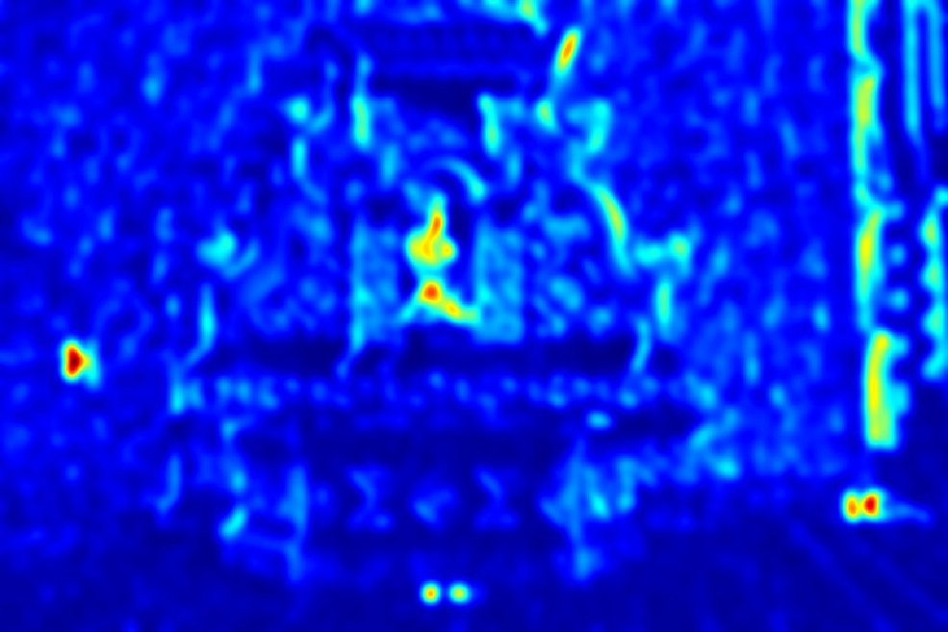
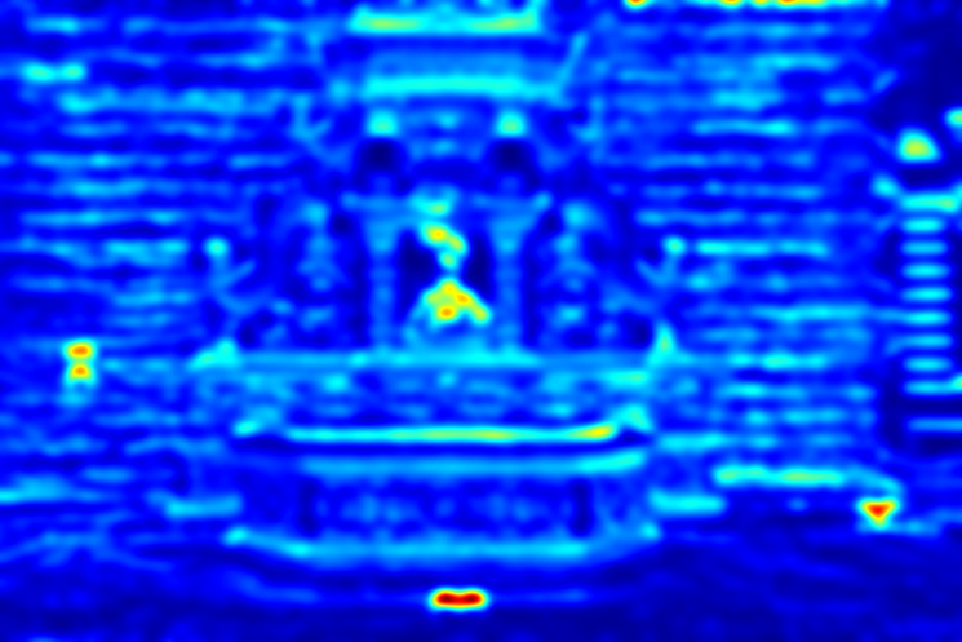
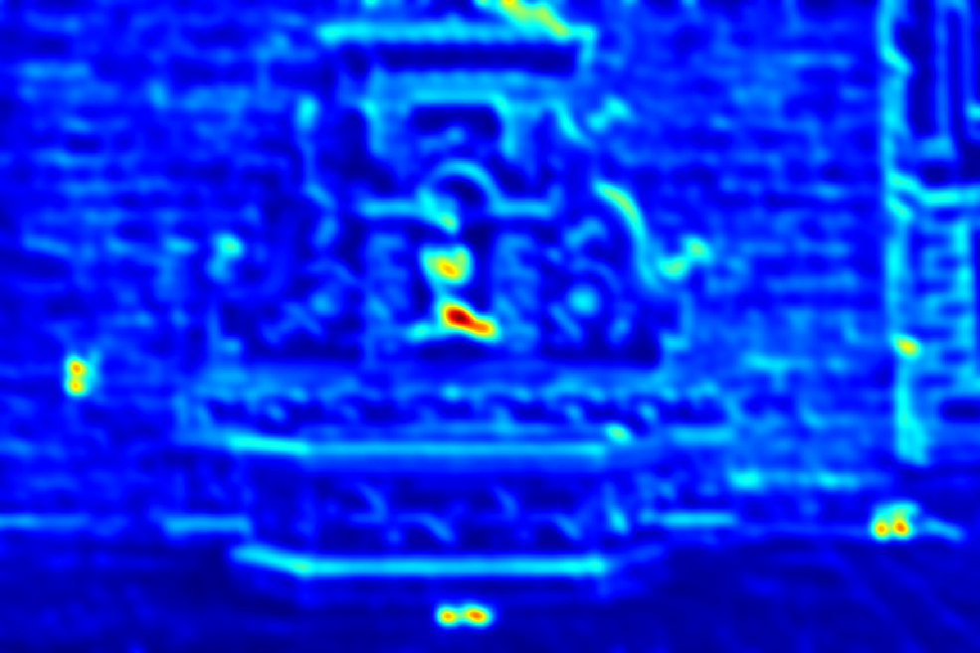
DAISY Computation
…
…
…
Notes:
Here, we outline our basic histogram computation: We first compute gradient magnitude layers in different orientations. Each of these layers are the magnitude of the gradient in a specific direction. Then, we apply convolution with a Gaussian kernel to pre-compute the histograms for every point. For example, to compute the histogram for this region, all we need to do is to read the corresponding values from the precomputed convoluted orientation layers.

Slide 14
DAISY Computation
…
…
…
Notes:
Since our regions are circular and since our weighing kernel is rotationally symmetric, when we want to compute the descriptor in a different orientation, these pre-computed layers are still valid but they only correspond to different bins of the histogram now.

Slide 15


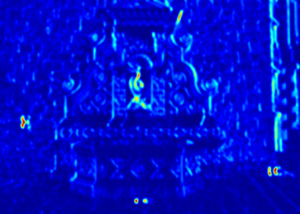
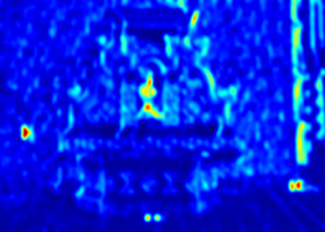
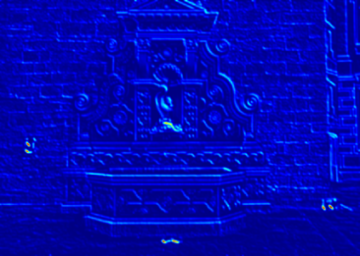


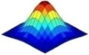
DAISY Computation
DAISY : 5s
SIFT : 250s
- Rotating the descriptor only involves reordering the histograms.
- The computation mostly involves 1D convolutions, which is fast.
Notes:
The overall procedure is described in this slide:
We first compute gradient magnitudes in different directions
We apply a Gaussian and sample these layers to compute the inner layer histograms.
We apply a successive Gaussian and sample for mid-region histograms
And finally apply a further Gaussian and get the whole descriptor.
This whole process takes about 5 seconds for an 800x600 image whereas it is around 250s for SIFT.
One more advantage with the Gaussian kernel is that, we can compute the histograms of relatively larger regions by applying smaller gaussians and also since it is separable we have quite a computational advantage in the convolutions.

Slide 16
Depth Map Estimation
Occlusion
Depthmap
Evidence
Smoothness Prior
Descriptors
Occlusions should be handled explicitly!
Notes:
Now, we use the computed descriptors in estimating the depth map with a standard formulation:
Given the descriptors, we want to estimate depth and occlusions
By applying Bayes and making the pixels explicit, we have a product of evidence with smoothness terms.
We use a the Alpha Expansion algorithm of Kolmogorov to solve this optimization problem but we could have used anything for this part.
There is a slight problem in using this directly however, since we are using a descriptor defined over a region and we must take care of pixels near the occlusion boundaries.

Slide 17
Depth Map Estimation
Occlusion Masks
P. of a specific Occlusion Mask
Evidence
Notes:
We handle this issue by modifying the evidence term slightly by introducing a set of mask and mask probabilities which are defined over the descriptor like this one. Here, while the matching energy is computed, only the histograms belonging to the shaded regions are considered.

Slide 18
Depth Map Estimation
Occlusion Masks
P. of a specific Occlusion Mask
Evidence
Notes:
There are a total of 9 masks.
We initialize the system with no occlusions which means using the first mask here.
Then we compute the mask probabilities and select the mask of each pixel and resolve the system.

Slide 19

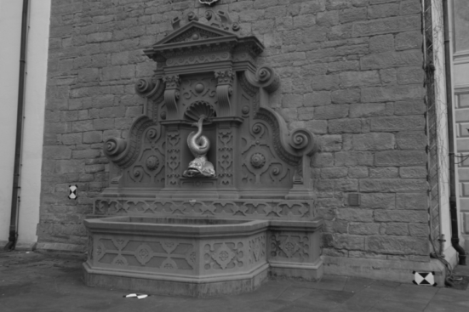

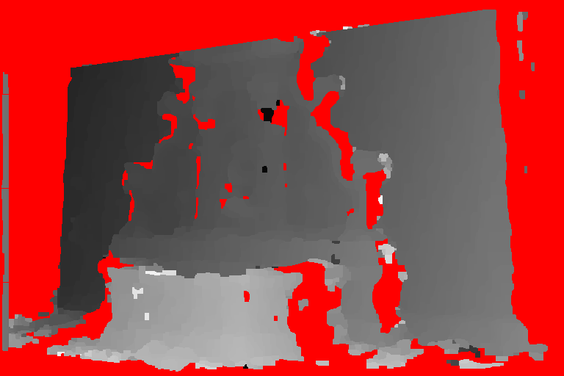
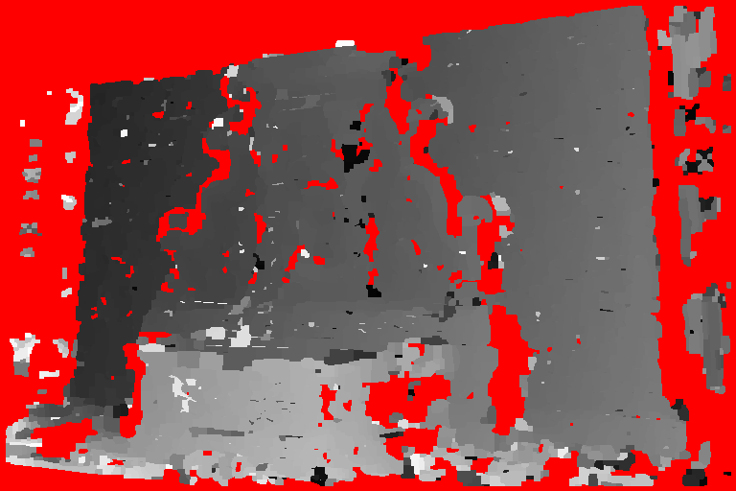
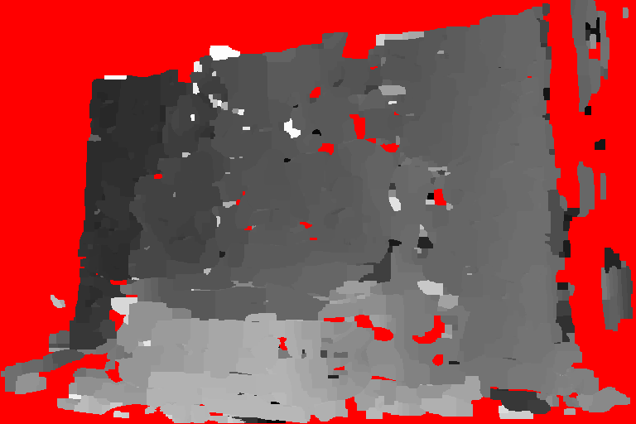
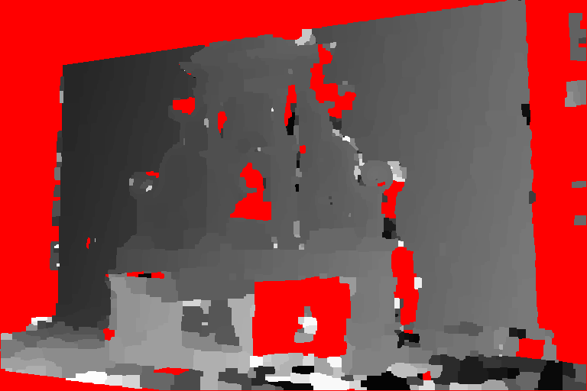
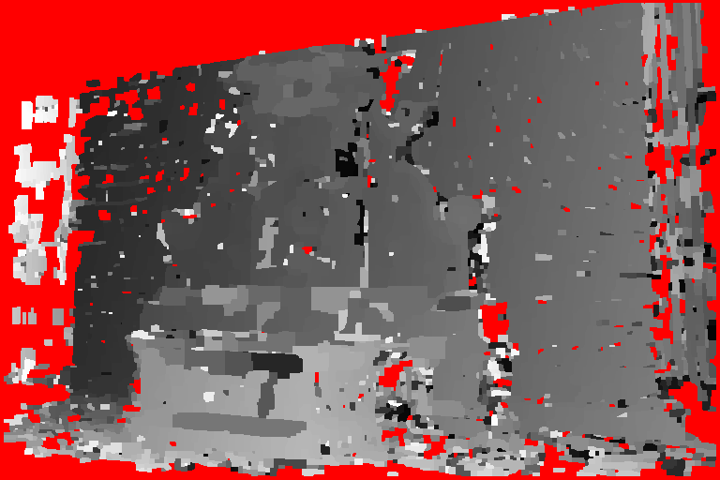
Experiments
Comparing against other Descriptors
Laser Scan
DAISY
SIFT
SURF
Pixel Diff
NCC
Notes:
Now, the experiments section. In this experiment we compare our descriptor’s result with 4 other matching schemes: SIFT, SURF, NCC and pixel differencing. We’ll show some numerical results in the next slide but in here we show some example reconstructions of the descriptors when we compute the depth map using these 2 images only. The red parts are detected occlusions and the depth map is represented in an inverse coding: light parts are close and dark parts are far. We see that DAISY result is the best one and SURF has many artifacts. This is not so surprising as it uses box-filters to approximate Gaussian kernels. This results in sharp changes in the descriptor of two side-by-side pixels and hence the artifacts.

Slide 20


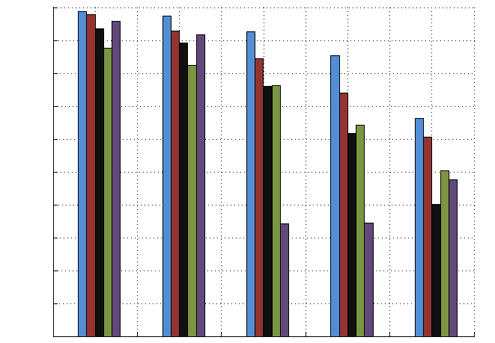



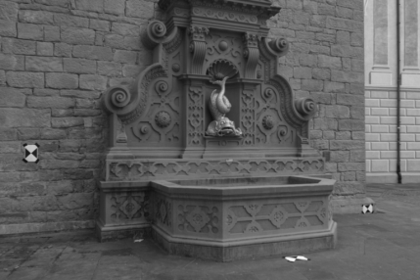
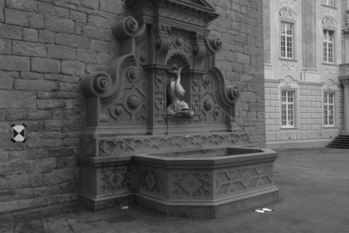
Experiments
Comparison with other Descriptors
Correct Depth % for Image Pairs
100
90
DAISY
80
70
SIFT
60
SURF
50
40
NCC
30
PIXEL
20
10
0
Notes:
Here we see some numerical comparison. We use the above image and one of the lower images in the estimation and compare our depth estimates to that of a laser scanned ground truth.
If you examine the lower images, you’ll realize that the baseline is increasing gradually from left to right.
Each block of bars here represent the result of a specific pair and the y-axis is the percentage of the correct depth pixels.
Within the bars, each color represents a specific descriptor. For clarity, we show the 5% error threshold which means that we count the depth estimate of a pixel as correct if its error is less than the 5% of the scene’s depth range. You can find more detailed comparisons in the paper.
From this graph, we see that DAISY always gives the best result and as the baseline increases its difference becomes more obvious. If you inspect the 1% error rate of SURF you’ll see that it is very low compared to the rest even when it is used for narrow baseline. This proves our previous observation about box filter usage for dense computations.
Occlusions are properly handled: We have a ground truth occlusion map. We do not consider the pixels in the GT occlusion map. However, if a pixel is marked as occluded but it is not in reality, then it is marked as false.

Slide 21
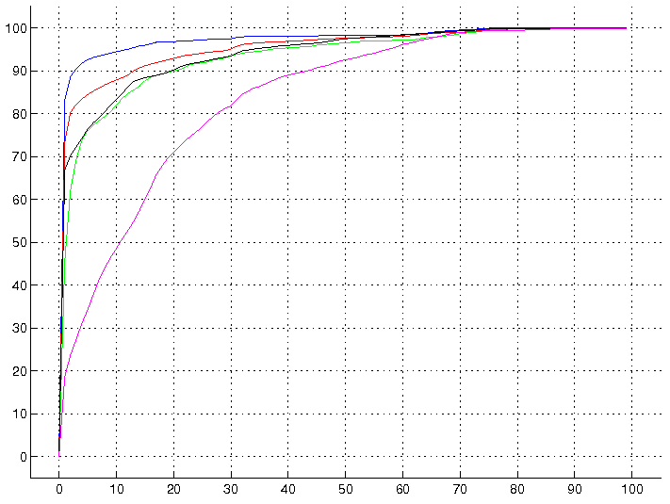
Experiments
Comparison with other Descriptors
Correct Depth % for Image Pairs
Correct Depth % vs Error Threshold
100
90
DAISY
80
70
SIFT
60
50
SURF
40
NCC
30
20
PIXEL
10
0
Notes:
For this image pair we also present a continuous graph where instead of a discrete error threshold, we present the correct depth % vs different error thresholds.

Slide 22
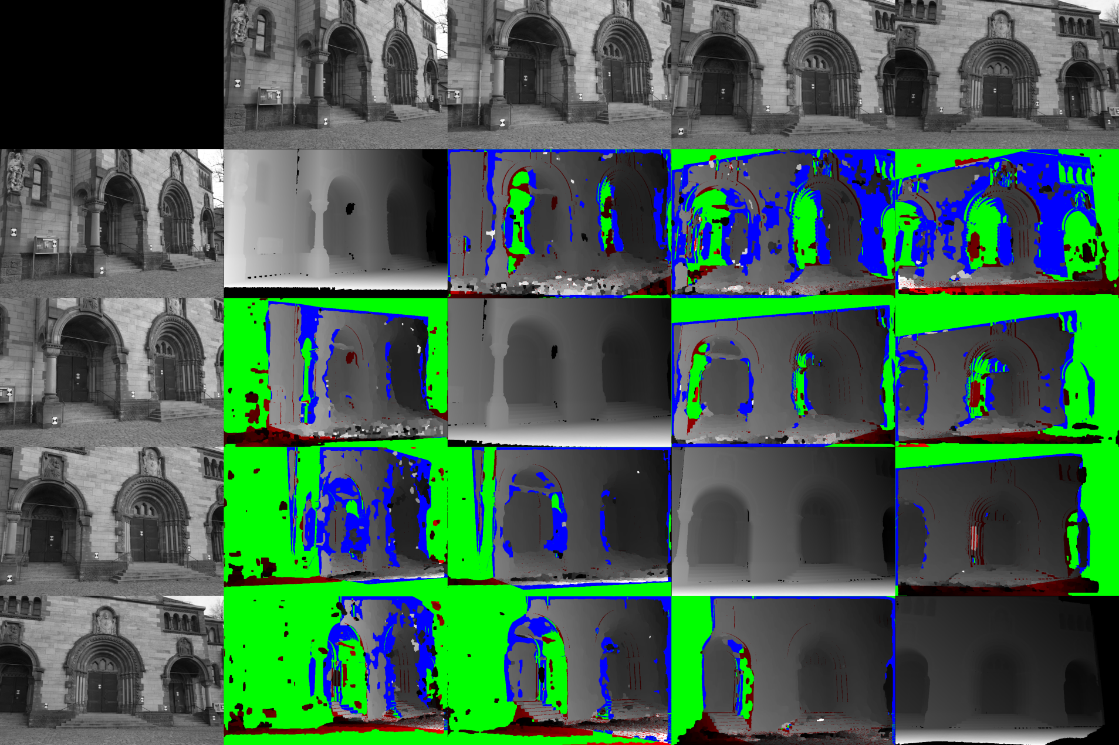
Herz-Jesu Sequence
Truly Occluded
Missed Depths
Missed Occlusions
87.4 %
83.9 %
83.8 %
84.9 %
91.8 %
91.8 %
83.2 %
90.8 %
93.5 %
80.2 %
89.4 %
90.7 %
Notes:
This is another GT experiment where we show only the results of DAISY. We basically use pairs of images one from the row and one from the column and compute the depth map wrt the upper row image. In the diagonal you see the GT depth map. In the depth maps, green represents the correctly detected occlusions, blue color falsely detected occlusions, red color missed occlusions and gray scale is the inverse depth.
We see that the depth and occlusion estimates are very good even in very wide baseline camera situations.

Slide 23
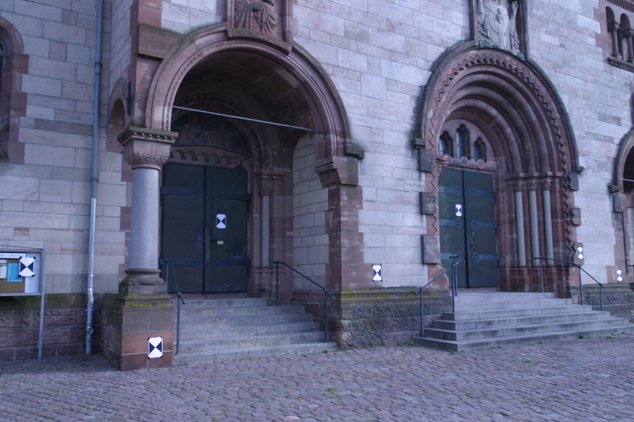
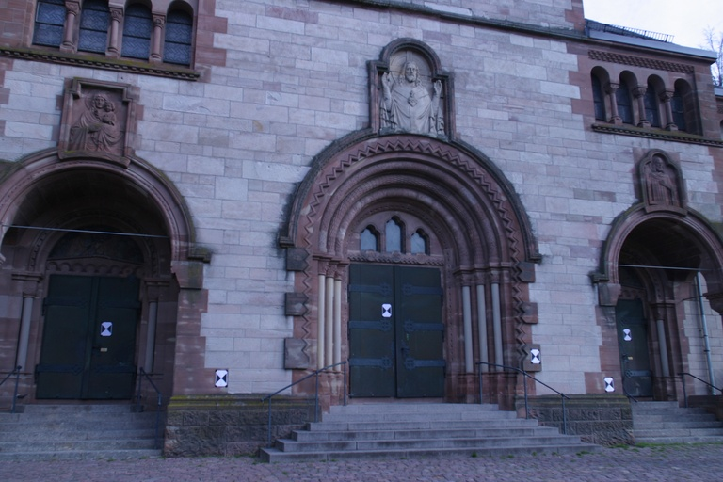
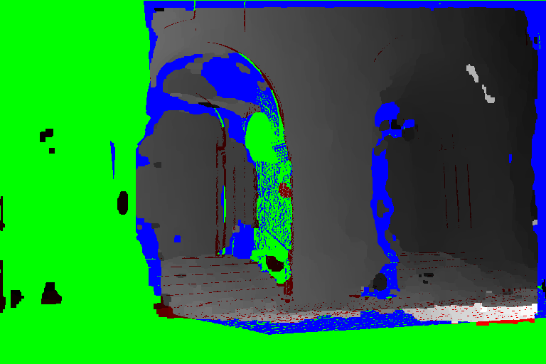
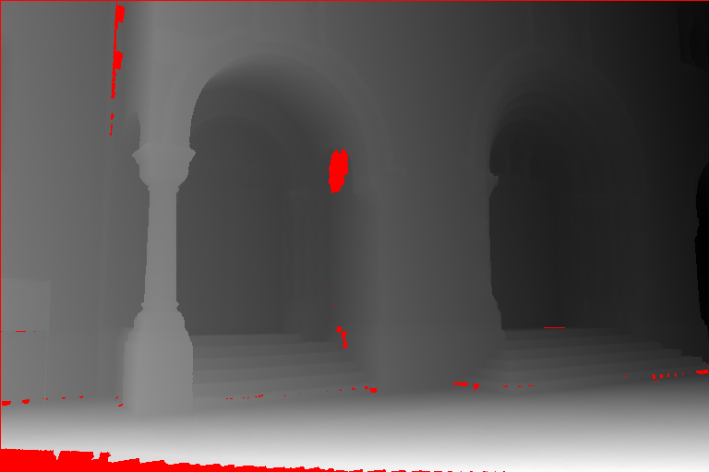
Herz-Jesu Sequence
DAISY
Ground Truth
Notes:
This is a close-up of one of the image pairs from the previous slide where the depth is computed wrt the first image.

Slide 24
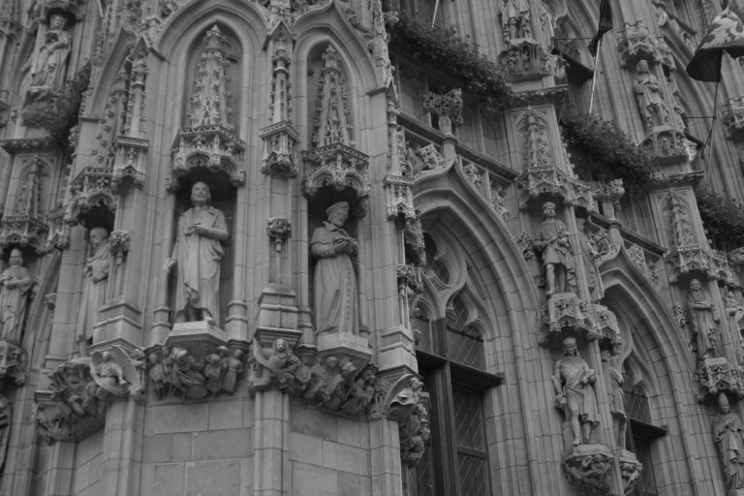
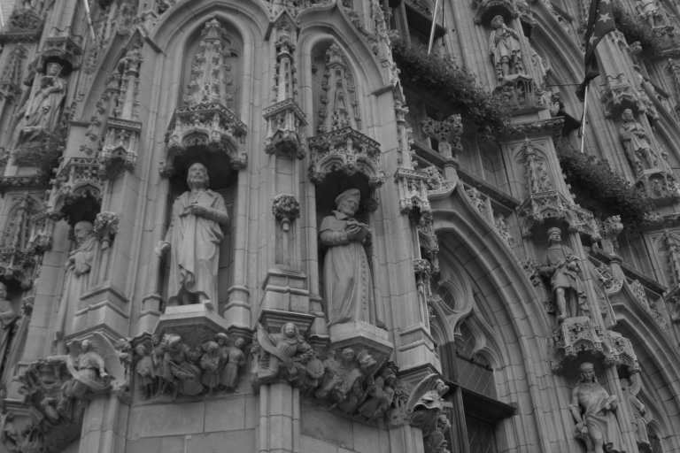
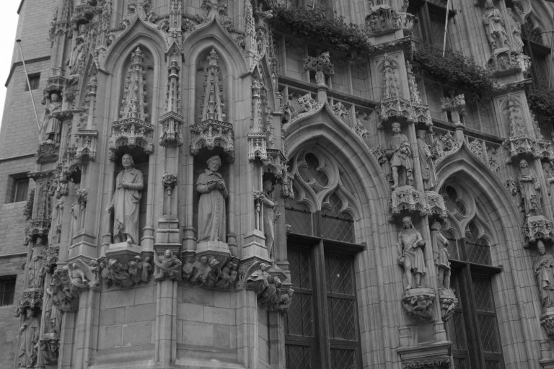
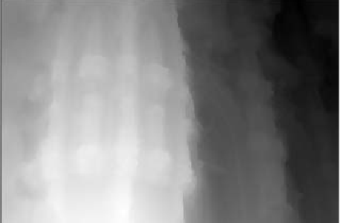
Comparison with Strecha’05
Strecha: 3072x2048
Strecha’05: Wide baseline stereo from Multiple Views: A probabilistic Account
Notes:
There are no existing wide baseline stereo algorithms in the literature that work on 2 images alone. For example, this is the results of one of the best wide baseline algorithms. It uses 4 images similar to these images of size 3072x2048 and produces this beautiful depth map.

Slide 25
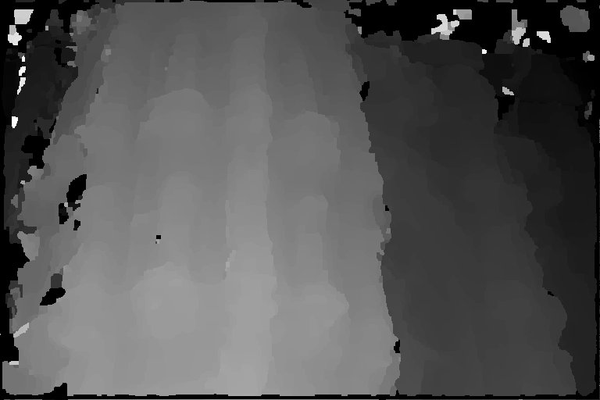
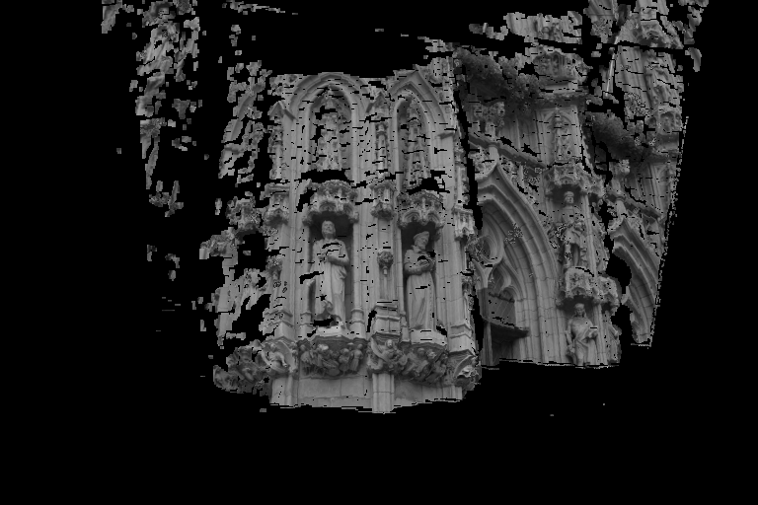
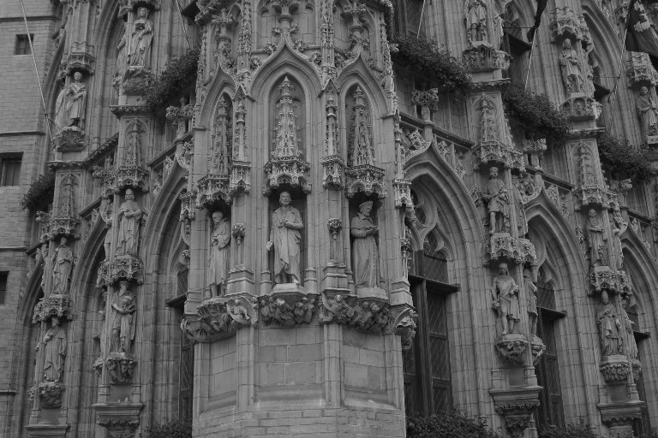
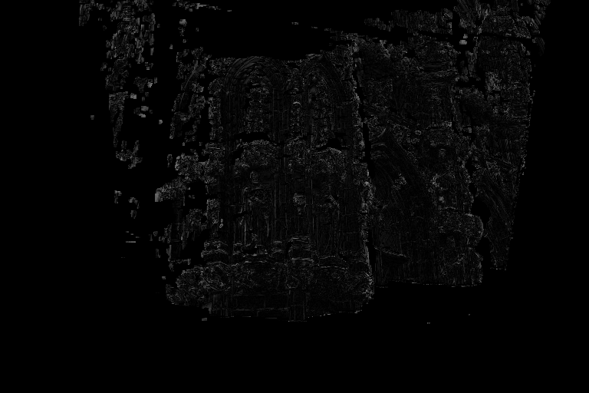
Comparison with Strecha’05
768x512
Strecha’05: Wide baseline stereo from Multiple Views: A probabilistic Account
Notes:
We tested our algorithm with lower resolution version of the images and used the computed depth map and this texture image to re-synthesize the image from this view point. You can see that there are very small errors in terms of intensity in the parts where we have a depth estimate.

Slide 26
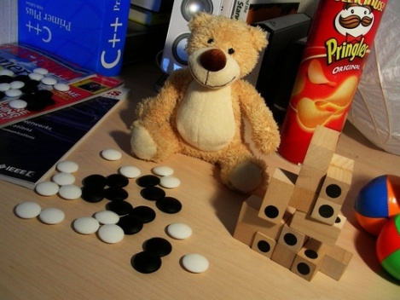
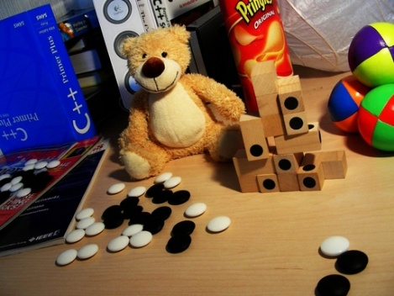
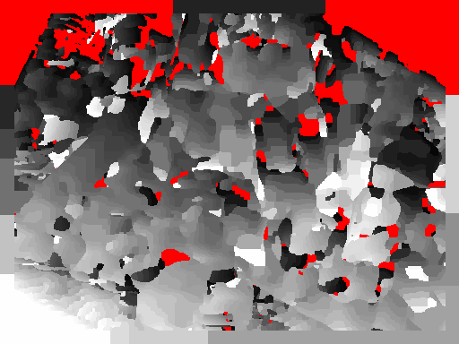
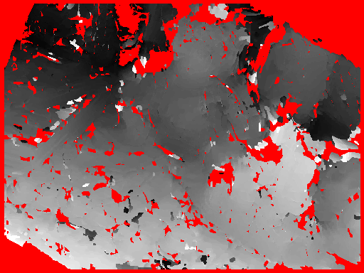
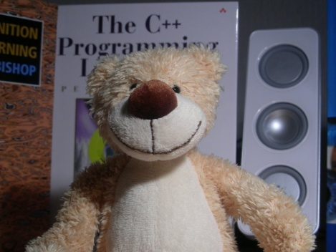







Image Transforms
Contrast Change
NCC
SIFT
Scale
Blurry Webcam Images
Notes:
Although it was not our purpose initially, the use of a histogram based descriptor actually makes our algorithm robust to other image transformations than the viewpoint change. We are almost impervious to contrast change, has some robustness versus the change in scale and image quality as shown in these examples. The first 2 images are the input images and the depth map is computed with respect to the first image. Here, you see the result of using NCC and SIFT descriptor.

Slide 27



Image Transforms
Contrast Change
NCC
DAISY
Scale
Blurry Webcam Images
Notes:
And here are the results of DAISY which are more cleaner and more accurate.

Slide 28
Conclusion
DAISY:
Efficient descriptor for dense wide baseline matching.
Handles occlusions correctly.
Robust to perspective distortions.
Robust to lighting changes.
Can handle low quality imagery.
Future work:
Image-based rendering from widely spaced cameras.
Object detection and recognition.
Notes:
To conclude, today we introduced a new and very efficient descriptor, DAISY. We also showed how we can use this descriptor to estimate depth maps respecting occlusions by introducing ‘masks over descriptors’. We gave comparison results with different descriptors using a GT, and we tested its performance limits with very harsh viewpoint changes. Also, we presented results which shows that the use of the descriptor grants us more robustness against various photometric transformations.
I believe there is no need to point out the other possible applications of having a fast dense descriptor but here’s a few of them anyway.

Slide 29
Source Code & Data
DAISY Source Code
http://cvlab.epfl.ch/software
Stereo Data and Ground Truth
http://cvlab.epfl.ch/data
C. Strecha et al. On Benchmarking Camera Calibration
and Multi-View Stereo for High Resolution Imagery, CVPR’08
Notes:
As a final note, if you’d like to test it yourself or use it in a different algorithm, the source code of daisy is available from our webpage.

Slide 30
Questions
DAISY Source Code
http://cvlab.epfl.ch/software
Images
http://cvlab.epfl.ch/data
http://cvlab.epfl.ch/~tola
Engin Tola
Notes:
Thank you very much! Any questions ?

Slide 31

QUESTIONS ?
DAISY Source Code
http://cvlab.epfl.ch/software
Images
http://cvlab.epfl.ch/data
http://cvlab.epfl.ch/~tola
Engin Tola

Slide 32

Parameter Selection
RQ:2->5
RQ:2->5
RQ:2->5
HQ=2
HQ=4
HQ=8
R: 5->30
THQ=2
R: 5->30
THQ=4
R: 5->30
THQ=8

Slide 33

Parameter Selection
Narrow Baseline
Wide Baseline
RQ:2->5
RQ:2->5
RQ:2->5
RQ:2->5
RQ:2->5
RQ:2->5
HQ=2
HQ=4
HQ=8
HQ=2
HQ=4
HQ=8
R: 5->30
R: 5->30
THQ=2
THQ=2
V:52
R=10, RQ=3, THQ=4, HQ=4
V:104
R=10, RQ=3, THQ=4, HQ=8
Max: 87 %
> 86 %
Max: 78%
> 77%
V:104
R=10, RQ=3, THQ=4, HQ=8
R: 5->30
R: 5->30
THQ=4
THQ=4
V:200
R=15, RQ=3, THQ=8, HQ=8
R: 5->30
R: 5->30
THQ=8
THQ=8
V:328
R=15, RQ=5, THQ=8, HQ=8
V:328
R=15, RQ=5, THQ=8, HQ=8
Notes:
We made some parameter estimation experiments on the descriptor and found out that we can use a smaller descriptor for narrow baseline stereo ( a vector of length 52 ). Also, it seems that we are using a higher complexity vector than it is necessary. In all the experiments in this paper, we used a vector of length 200, but it seems from this experiment that we could have used a vector of size 104.

Slide 34


Parameter Selection
Narrow Baseline
Wide Baseline
Q:1->5
Q:1->5
Q:1->5
Q:1->5
Q:1->5
Q:1->5
H=2
H=4
H=8
H=2
H=4
H=8
100
R: 5->30
R: 5->30
TQ=2
TQ=2
R: 5->30
R: 5->30
TQ=4
TQ=4
TQ=8
TQ=8
R: 5->30
R: 5->30
0
Notes:
We made some parameter estimation experiments on the descriptor and found out that we can use a smaller descriptor for narrow baseline stereo ( a vector of length 52 ). Also, it seems that we are using a higher complexity vector than it is necessary. In all the experiments in this paper, we used a vector of length 200, but it seems from this experiment that we could have used a vector of size 104.

